Slide 1

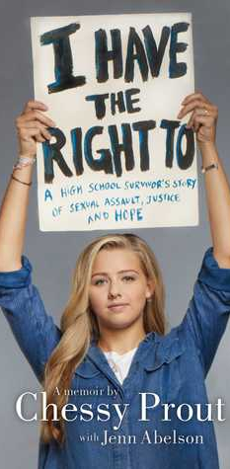
I Have The Right To: A High School Survivor’s Story of Sexual Assault, Justice, and Hope A Memoir by: Chessy Prout with Jenn Abelson
By: Kendralyn Burr

Slide 2
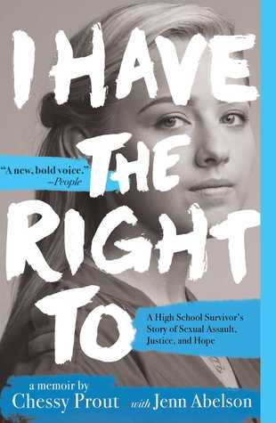
I Have the Right To: A High School Survivor's Story of Sexual Assault, Justice, and Hope is a memoir of Chessy Prout’s high school experience. With the help of Jenn Abelson, Chessy writes and emotional, inspiring story of sexual assault, the aftermath, and her journey to recovery. One evening at St. Paul’s School, a boarding school in Concord, New Hampshire, Chessy, 15-year old freshmen is sexually assaulted by Owen Labrie, an 18-year old senior. Afterward, Chessy is bullied by friends and strangers. Chessy is a survivor and she never gives up as she struggles with depression, anxiety, and bullying. With the support of her family, she becomes an advocate for sexual violence and spreads awareness on the way victims and survivors are treated by society. This story is easy to read despite the content of the material being about sexual abuse. Photos of Chessy and her family and friends are included to help tell her story.
Sexual abuse can happen to anyone at any age. It is important to inform youth of ways to handle situations of this nature. This true story can inspire young adults on ways to handle these situations and is recommended for teens. Because there are graphic details of the assault, parental guidance is recommended. Public Libraries should have content of this nature in their collection.
This story was published by Margaret K. McElderry Books on March 6th, 2018. The hardcover has 416 pages and can be purchased from Amazon for $14.64.

